Slide 1
Honors Biology
Designing Controlled Experiments for Honors Biology

Slide 2
Types of Reasoning
Inductive – specific observations lead to general principles
Discovery Science, Ex: Cell theory
Must not confuse observation and inference
Deductive – general principles lead to specific results
Hypothesis based – If…then predictions
Requires correct experimentation
Referred to as the Scientific Method

Slide 3
Deductive reasoning requires experimentation

Slide 4
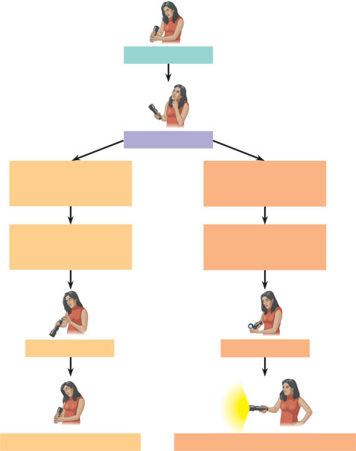
A campground example of hypothesis-based inquiry
Observations
Questions
Hypothesis # 1: Dead batteries
Hypothesis # 2: Burnt-out bulb
Prediction:
Replacing batteries
will fix problem
Prediction:
Replacing bulb
will fix problem
Test prediction
Test prediction
Test falsifies hypothesis
Test does not falsify hypothesis

Slide 6
How do we design experiments in Science?
We will use an example of designing an experiment to understand what gibberellin (a plant hormone) does to plants

Slide 7
Search the literature.
Example: Before doing the experiment conduct a literature search about the response of plants to the hormone gibberellin
Search for previous studies on effects
Search for how to grow plants
Search for what plants to use
Search for how to best care for the plants
Etc.

Slide 8
State your hypothesis.
Example: I hypothesize that the application of gibberellin will cause cell elongation and increased height in dwarf pea plants.
Cell elongation and plant height are measurable
Dwarf pea plants is narrow enough to be done

Slide 9
Manipulate ONE variable.
Example: One group of 5 dwarf pea plants received a spray of 500 ppm gibberellin while the other group of 5 dwarf pea plants was sprayed with the solvent water
Specific amount of gibberellin
Not changing anything but gibberellin

Slide 10
Hold constant all other variables.
Example: Both groups of plants (experimental and control group) were exposed to the same intensity of light for the same duration each day
Specifically list some things you need to hold constant between the two groups

Slide 11
Identify the control group.
It may help to think of the control group as a point of reference.
Example: The group of 5 dwarf pea plants sprayed with the solvent water, served as the control group
What will you compare to to see what happened?

Slide 12
Make quantitative measurements.
Example: A ruler was used to measure the heights of both control and experimental plants at intervals of three days for a month following the spraying of both groups.
Be as specific and numerical as possible
Say what tool you will use to measure

Slide 13
Verify the experimental results
Example: This experiment was repeated three times to verify or confirm the results.
One way to verify is for you or others to repeat your experiment
You can also verify by using a large sample size
In this class we will verify by doing the same experiment 6 times at once

Slide 14
Statistically analyze the results.
Example: The results of three trials were averaged.
You can do Chi squared, average, find the rate, whatever is appropriate

Slide 15
Relate the expected results to the hypothesis
Example: If the plants sprayed with gibberellin experienced greater growth over the 30 day period the hypothesis would be supported.
Is your hypothesis true or false?
Don’t have any conclusion that isn’t what your experiment is set up to test

Slide 16
What does the study of Biology involve?

Slide 17
Levels of Organization in Biology
Biosphere
Ecosystems
Communities
Populations
Organisms
Organs
Tissues
Cells
Organelles
Molecules

Slide 18
Different measurements used in different types of Biology
Always Use metric
Kilogram, Liter, Meter, Celsius
Prefixes always the same – YOU MUST KNOW
Kilo
Centi
Milli
Micro
Nano

Slide 19
Biology is the application of science to living things
SO….
What is Alive??

Slide 20
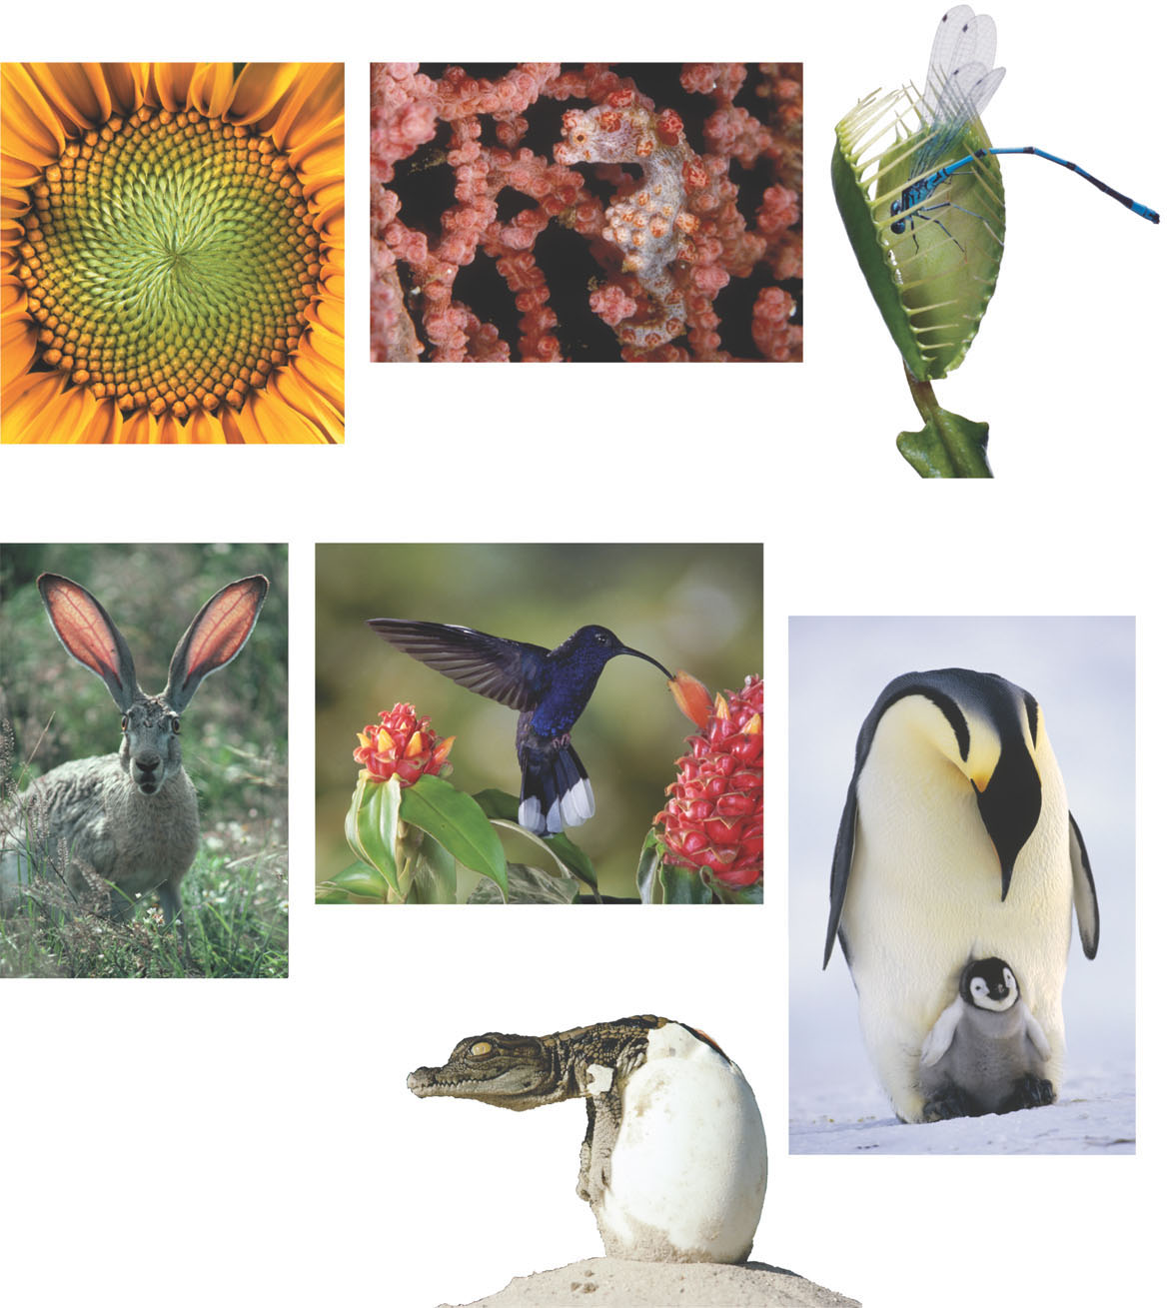
Some properties of life
(b) Evolutionary adaptation
(a) Order - Cells
(c) Response to the environment
(e) Energy processing
(d) Regulation
(f) Growth and development
(g) Reproduction

Slide 21
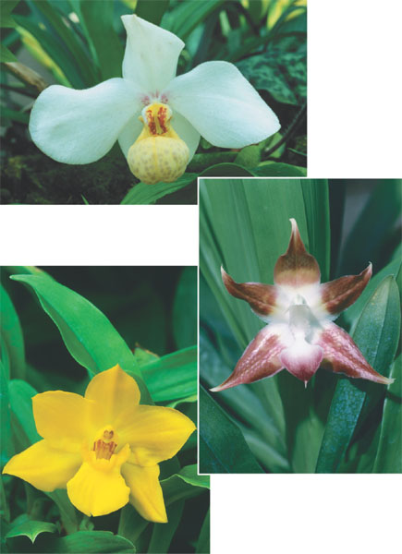
Unity and diversity in the orchid family

Slide 22
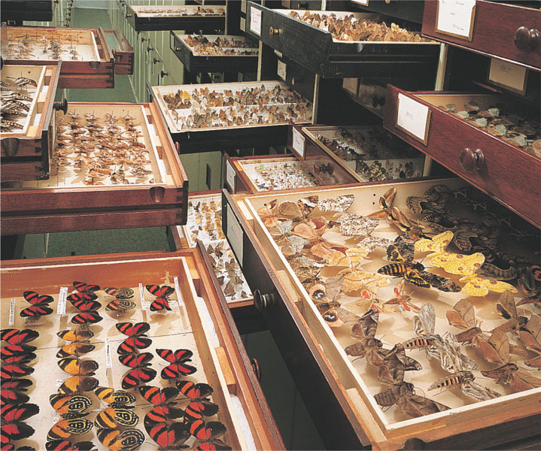
Drawers of diversity

Slide 23
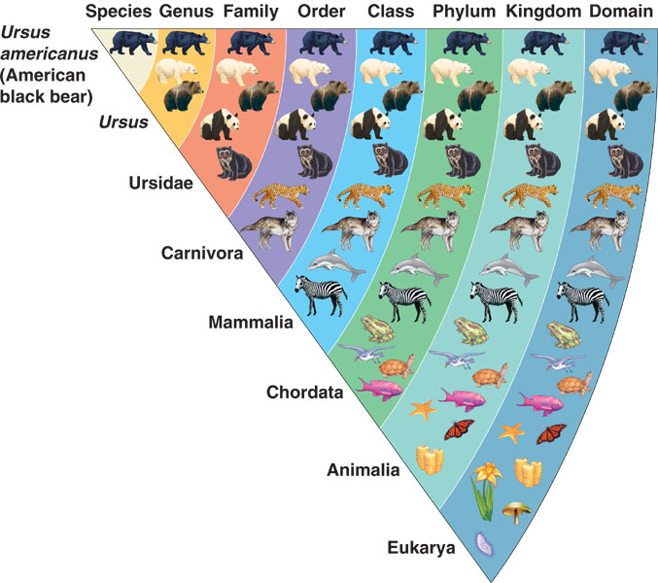

Slide 24
Biological Domains
Archea
ancient prokaryotes
extremophiles

Slide 25
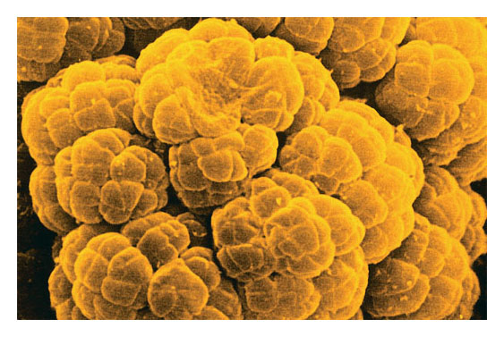
Archea
ancient prokaryotes
extremophiles

Slide 26
Bacteria
Prokaryotes
Diverse and ubiquitous
(I love that word)

Slide 27
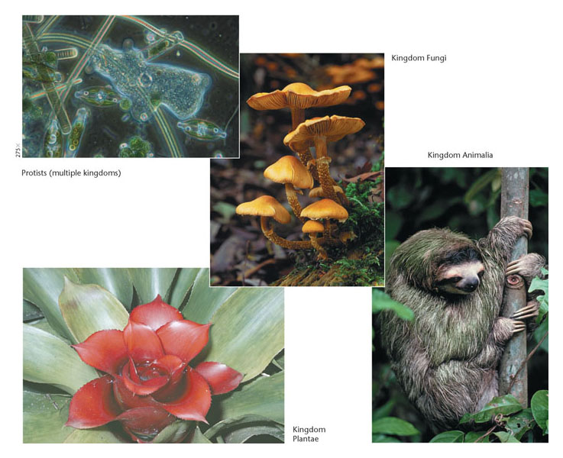
Eukarya
Eukaryotes
Four Kingdoms – protists, fungi, plantae, and animalia

